Slide 1
NBA: Bayesian Skill Ranking
Leland Chen, Joseph Huang, Ryan Thompson

Slide 2
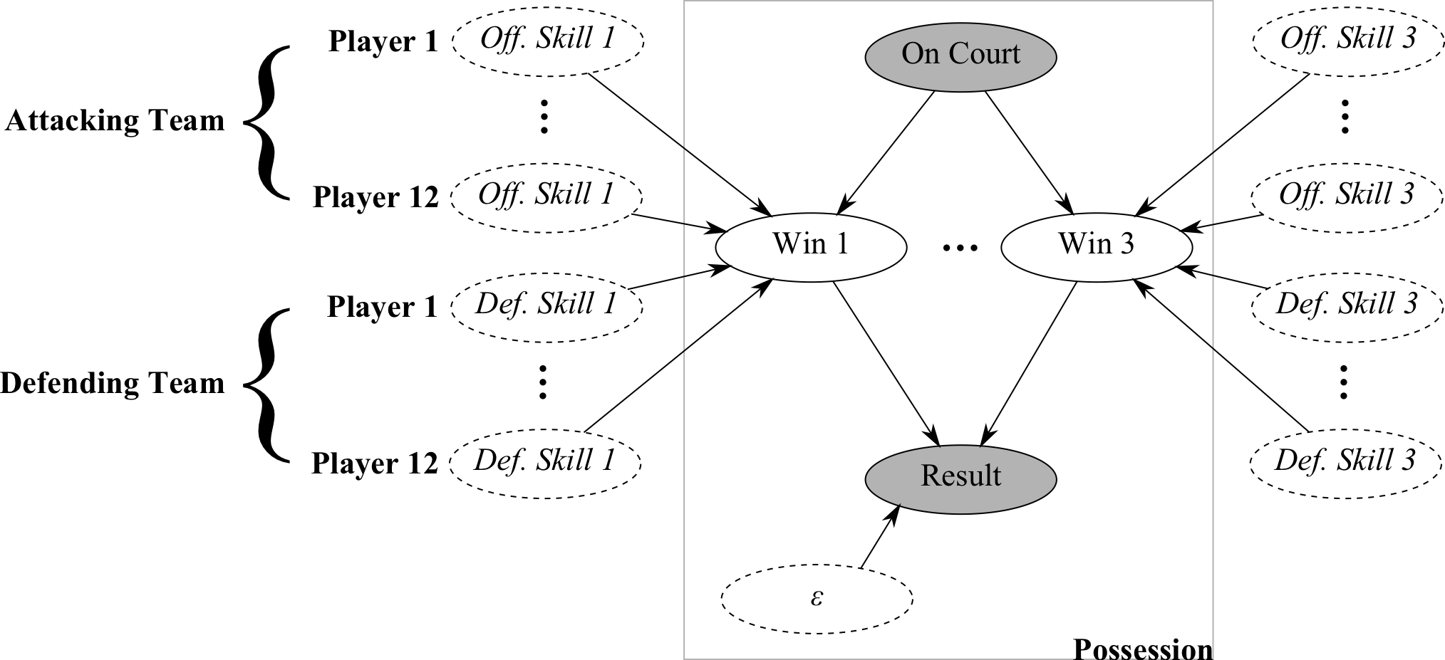
Proposed Network

Slide 3
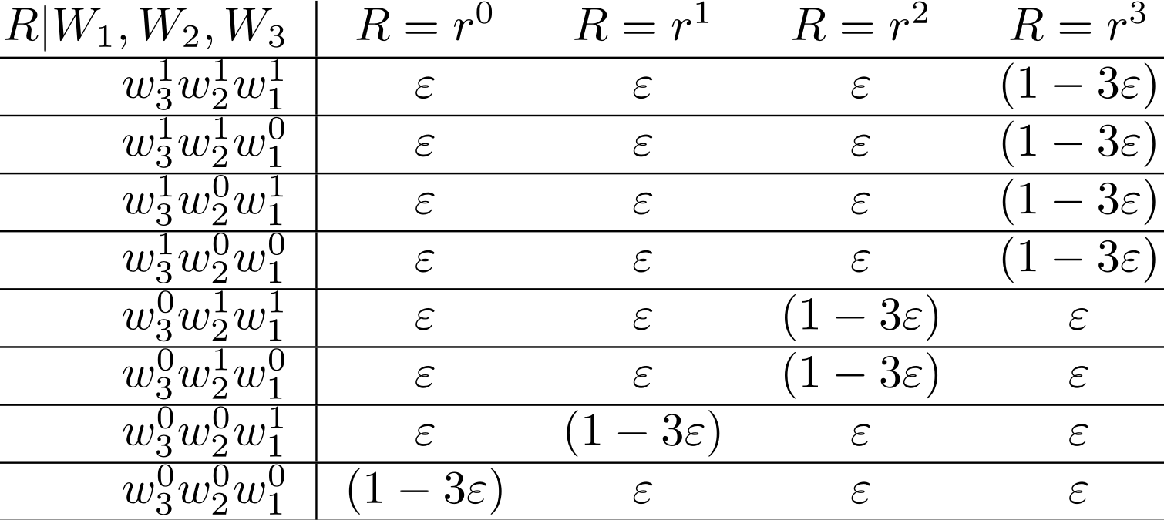

Slide 4
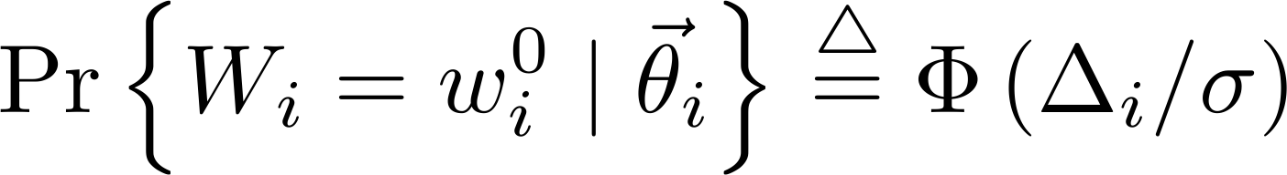
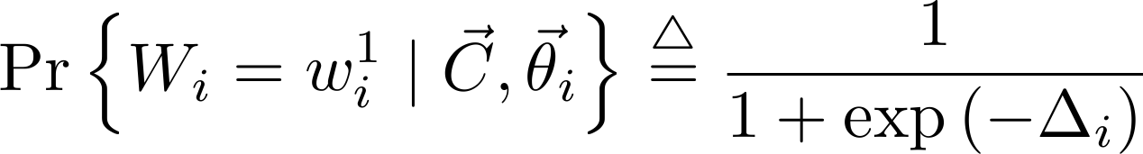
Gaussian
Logistic

Slide 5
Case Study
Offensive/Defensive Skills
 | Off. 1 pt | Off. 2 pt | Off. 3 pt | Def. 1 pt | Def. 2 pt | Def. 3 pt
Zydrunas Ilgauskas | -52.282 | 9.000 | 34.708 | 16.104 | 18.088 | 7.638
Offensive Skills: Higher the better
Defensive Skills: Lower the better
1 complete game; 183 total possessions
Traditional Box Score
 | FGM-A | 3GM-A | FTM-A | OFF-DEF-TOT | +/- | STL | BLK | PTS
Zydrunas Ilgauskas | 7-11 | 0-0 | 0-0 | 4-6-10 | +2 | 1 | 1 | 14
CLE @ DET, March 07, 2007. 101-97 OT.

Slide 6
Future Work
Conclusion
Smoothing/Bayesian Prior
Coach Skill
Even More Data
New way to rank players based on individual contributions

Slide 7
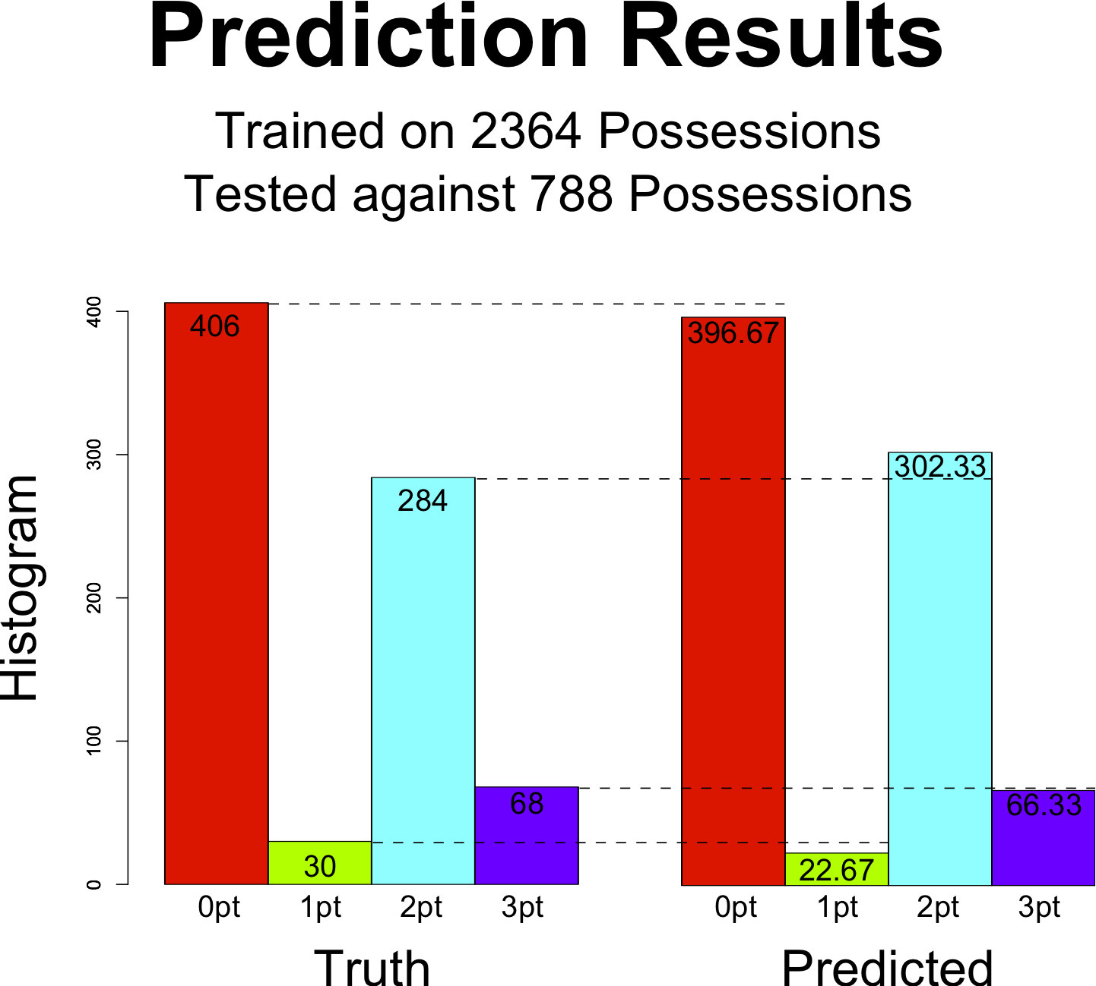
Southwest Division 2008-2009
Top 2 pt Off./Def. Players
(600+ possessions)
Off. 2 pt | Def. 2 pt | Player
0.478 | -0.528 | Jason Terry
0.620 | -0.270 | Yao Ming
0.391 | -0.179 | Luis Scola
0.212 | -0.214 | Kyle Lowry
0.240 | -0.185 | Tim Duncan
-0.029 | -0.029 | League Avg.
Offensive Skills: Higher the better
Defensive Skills: Lower the better
35 games; 3152 1st half possessions

